Slide 1

Introduction to R
Barney Sanderson
November 24

Slide 2

Introduction to R
3 x 2 hour sessions, over three weeks
Assumes no prior knowledge
Taught and practical components
No assignments or tests!

Slide 3
Course Objectives
Learn the concepts, tools and skills required to:
Use R
Learn (more) about R
Foundation in reproducible research
Exposure to the jargon of programming
How to find help

Slide 4
Introduction to R
Your tutor is opinionated
Bias alert!
Text based computer user
Windows vs MacOS
Not complete!

Slide 5
Session 1
Introduction
What is R?
Interacting with R
RStudio orientation
R fundamentals
Objects
Functions
Vectors and data types
Packages
Help!

Slide 6

Session 2
Tabular data
dplyr vs base R
Wrangling data
Tidy data
Filtering
Altering
Wide vs Long
Merge data

Slide 7

Session 3
More wrangling data
Grouping and summarising
Importing data
Plotting data
Base R
ggplot2
Organising projects

Slide 8
Session Format
Working install of RStudio needed to follow along
Live code demos!
Swap between PowerPoint and RStudio
Monospaced font indicates R code
print("R code")

Slide 9
Introduction to R
Barney Sanderson
November 24

Slide 10
Session 1 - Objectives
Understand what R is (and why it’s great!)
Learn how to interact with R
Introduction to differences and links between R and RStudio
Understand objects and functions
Understand vectors and data types

Slide 11
Session 1 - Objectives
Understand what R is (and why it’s great!)
Learn how to interact with R
Introduction to differences and links between R and RStudio
Understand objects, data types and vectors
Understand what functions are
Part 1
Part 2

Slide 12
Session 1 - Material
Session material are available at:
https://github.com/bakenzua/gstt_critical_care_introduction_to_r/
Materials will be updated

Slide 13

What is R?
A program
An environment
A programming language

Slide 14
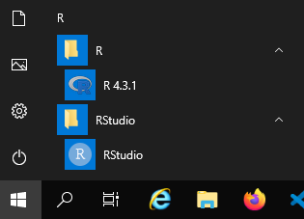
What is R?
R is a program

Slide 15
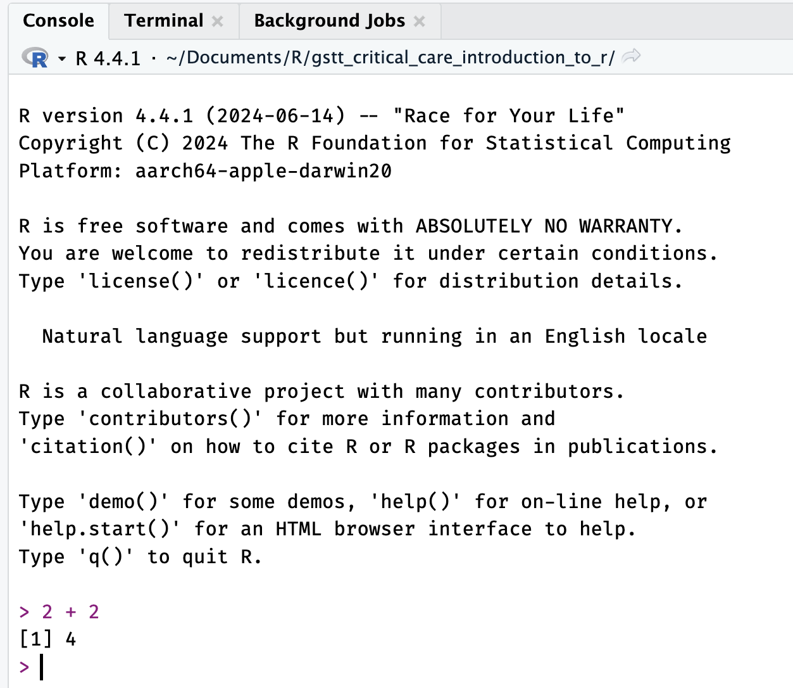
What is R?
R is a program

Slide 16
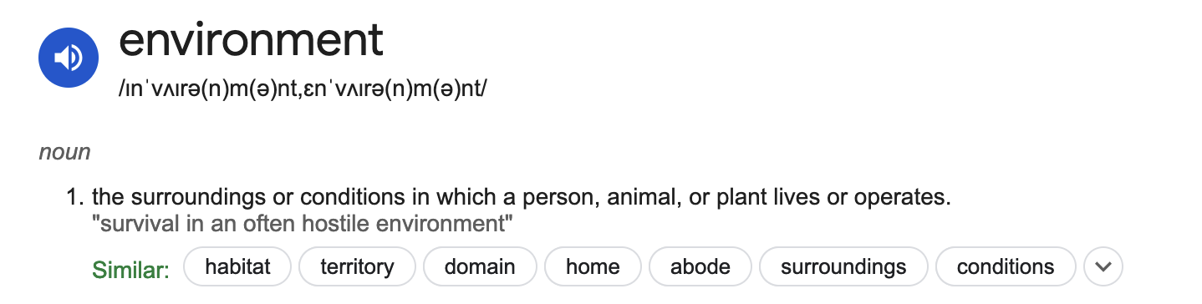
What is R?
R is an environment

Slide 17
What is R?
R is an environment for statistical computing and graphics.
Data manipulation
Calculation
Graphical display

Slide 18
What is R?
R is a programming language

Slide 19
What is R?
R is a language
Communicate with other people
Including yourself!
Clearly describe manipulation and analysis of data
Communicate with a computer

Slide 20
What is R?
R is a language
Based on a language called S
Easily extended
16,000+ packages
Easily interfaces with other software libraries and programming languages

Slide 21
What is R?
R is a language
Syntax and grammar
Names
Naming things is hard!
Regional dialects
R is for data wrangling and analysis
tidyverse dialect
Idioms

Slide 22
What is R?
R is a language
Learn languages through use
Read code
Write code

Slide 23







What is R?
Statistics Package
Programming Language

Slide 24
Why learn R?
Beginner friendly
R is text-based and so does not require lots of pointing and clicking
This is a good thing!!
Reproducible research
R is free and open source
R has a fantastic community, making it easy to find help or resources

Slide 25
Why learn R?
R can produce high quality graphics
ggplot2
Endlessly customisable
Many extensions for different plot types

Slide 26
Why learn R?
R is an industry standard
Mathematicians
Statisticians
Academic
Applied
Image analysis, GIS, time series, population genetics
Publish their work as R code – often as packages
Problems that arise in data manipulation and analysis occur repeatedly, there will be solutions

Slide 27
Why learn R?
R is a language, used by people manipulating and analysing data
R is especially suited to this work
Domain specific languages
tidyverse

Slide 28
Interacting with R
Interact with R environment via text or R code
R console
Type commands into the console
View results (or feedback, or maybe errors!)
Collect R commands in script files
Run these in the R environment
Analogous to typing in the code into the console
Script files allow the same routines to be run repeatedly

Slide 29
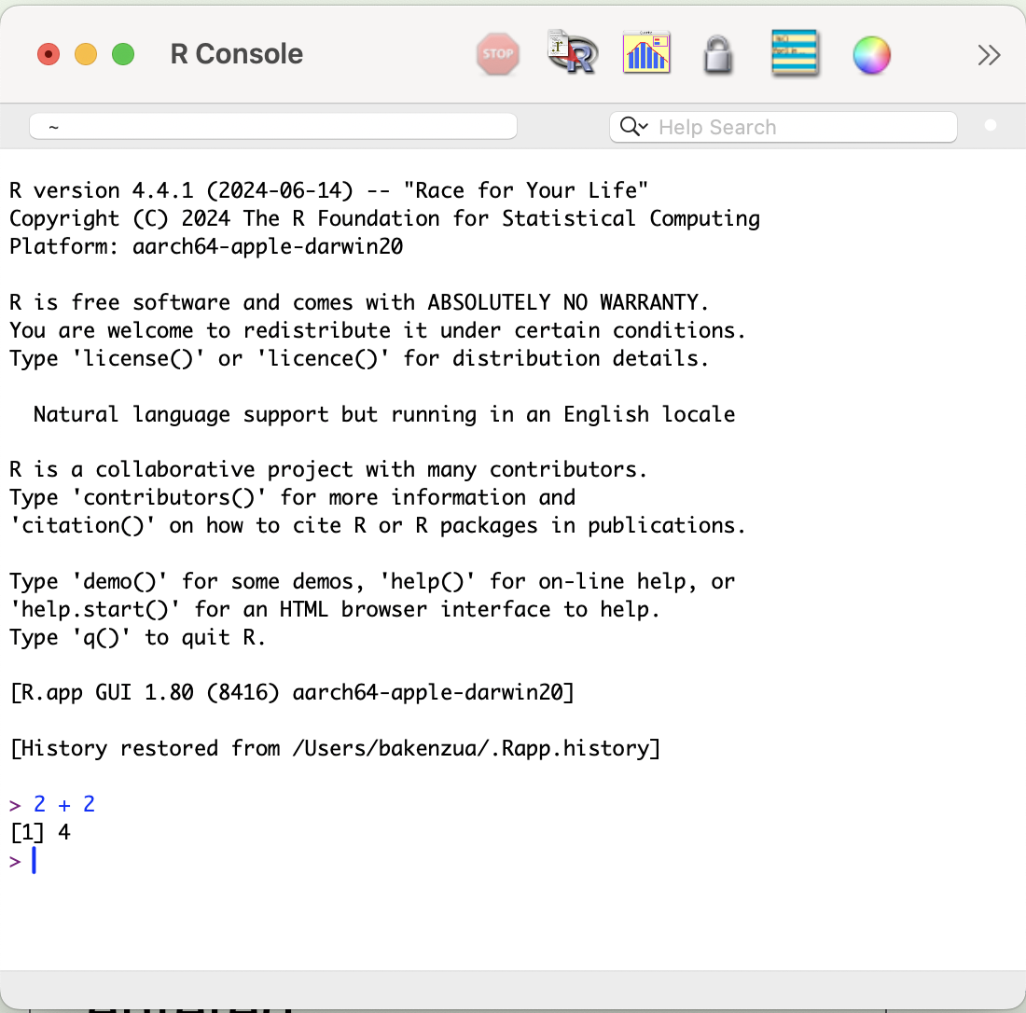
Interacting with R
Open the R console
Enter a calculation with numbers and arithmetic operators: + - / * ^
2 + 40
Press return ⏎
Pressing return ⏎ asks R to evaluate the commands entered

Slide 30
Interacting with R
2 + 40
[1] 42
Commands are on lines starting with ">" symbol
Results return on lines without ">" symbol
We can ignore "[1]" for now

Slide 31
Interacting with R
Enter another calculation
2000 / 80
[1] 25
Press the up arrow
This scrolls back through a history of commands entered
Previous commands can be edited and evaluated again

Slide 32
Interacting with R
2 +
+
"2 + " is an incomplete set of commands or instructions
R starts the next line with a "+" sign to indicate that additional commands are required before they can be evaluated and a result returned
Close R, no need to "save workspace image"

Slide 33
Interacting with R
Manually entering commands to the R console
Useful for quick calculations, checks and trouble shooting
Tedious beyond simple calculations
Collect R commands in script files
Code and workflow are more reproducible
Requires an editor
Common choice is RStudio

Slide 34

RStudio
RStudio a set of tools built around the R console
Presented through a graphical interface
Edit code
View plots and tables
Project management

Slide 35
RStudio
RStudio is a set of tools built around the R console
Presented through a graphical interface
Edit code
View plots and tables
Project management
Includes reproducible research tools, e.g. Quarto and RMarkdown

Slide 36
What is RStudio?
Statistics Package
Programming Language

Slide 37
What is RStudio?
Statistics Package
Programming Language

Slide 38

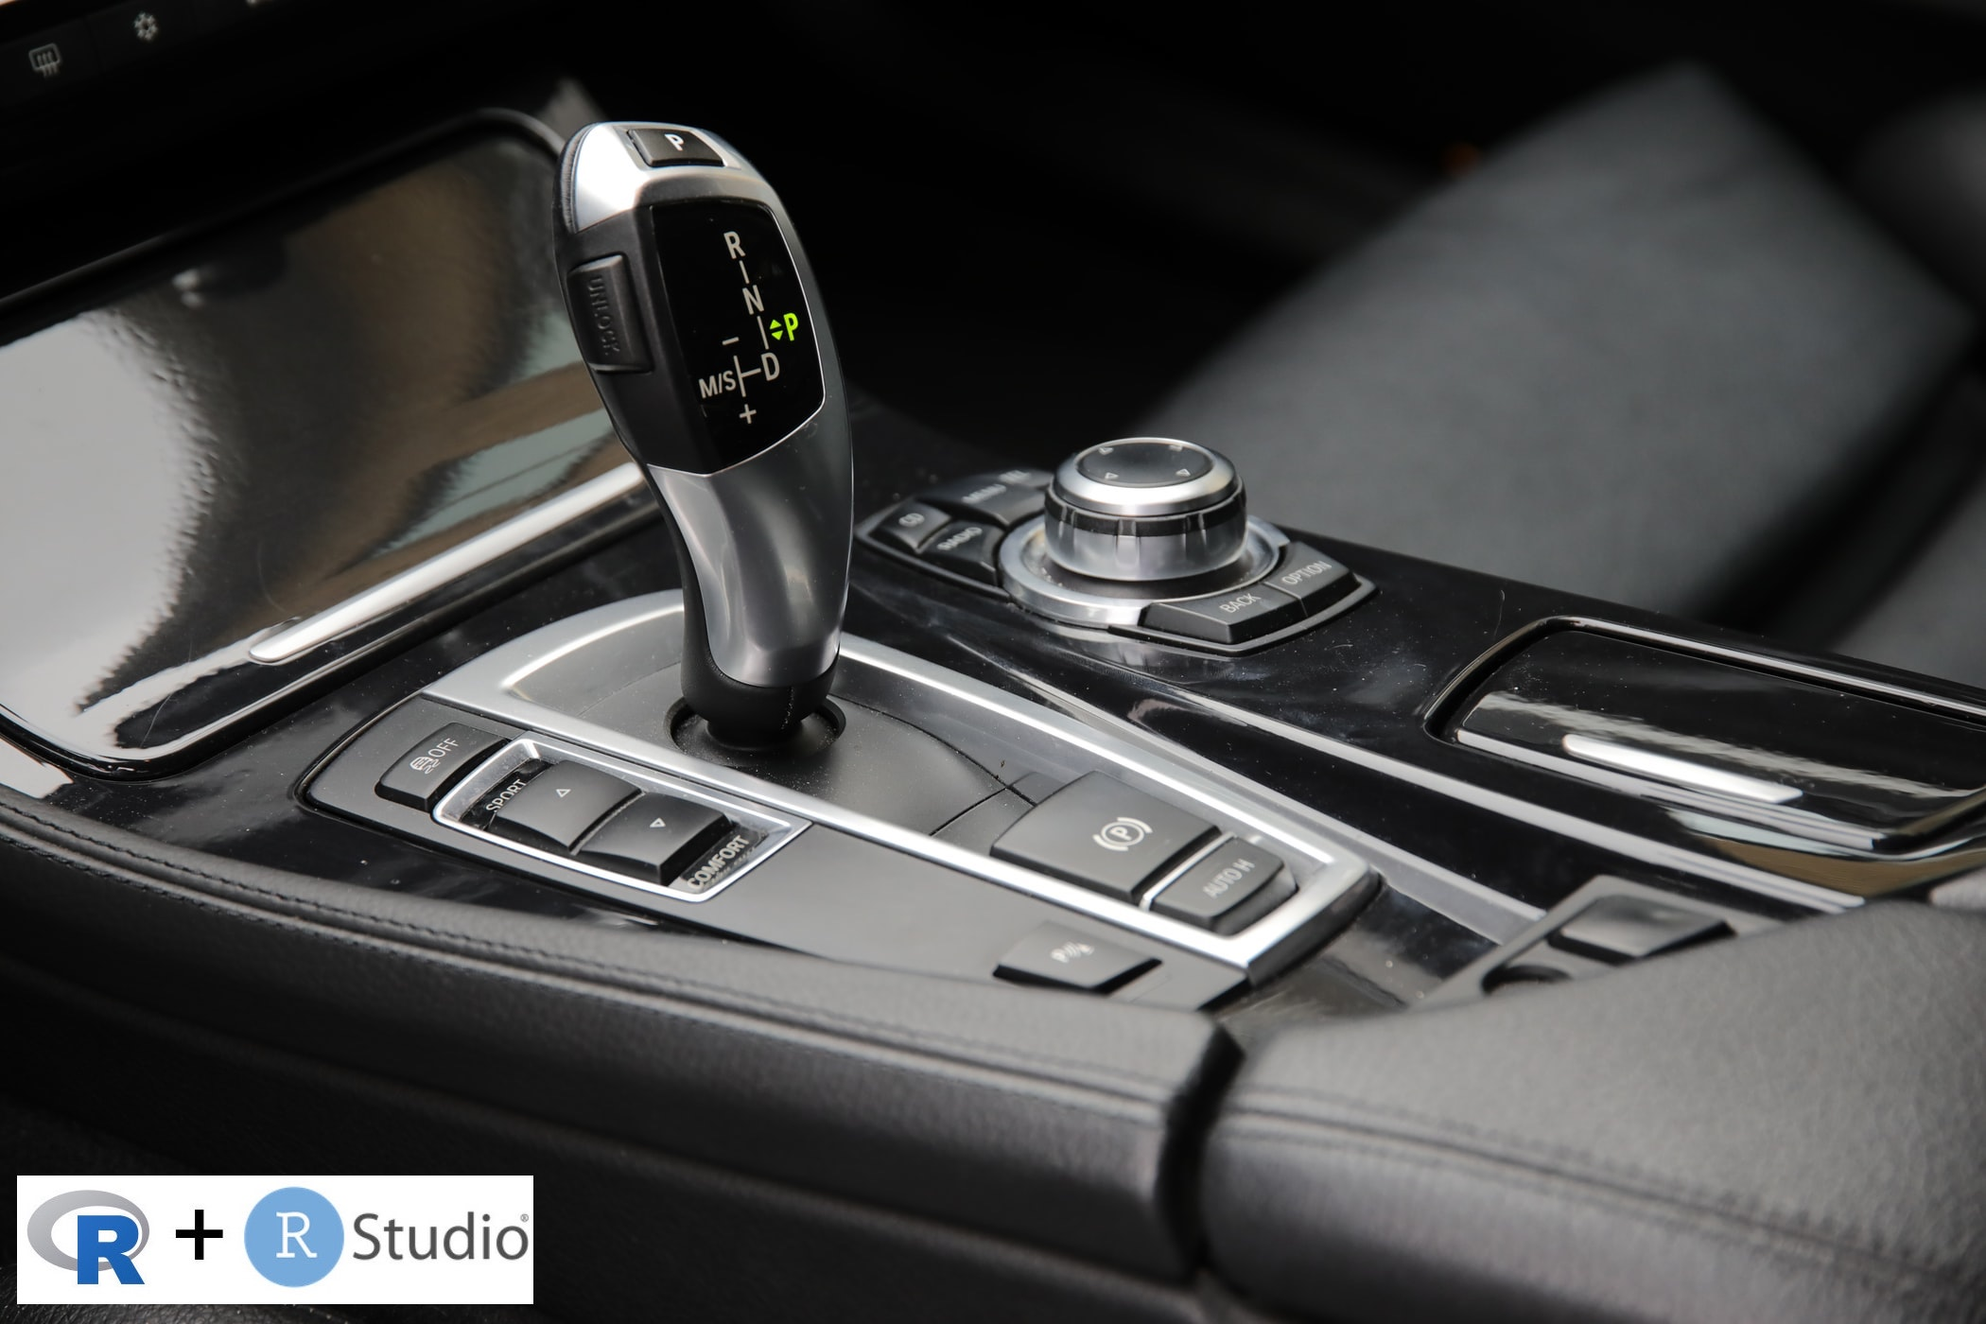
What is RStudio?

Slide 39
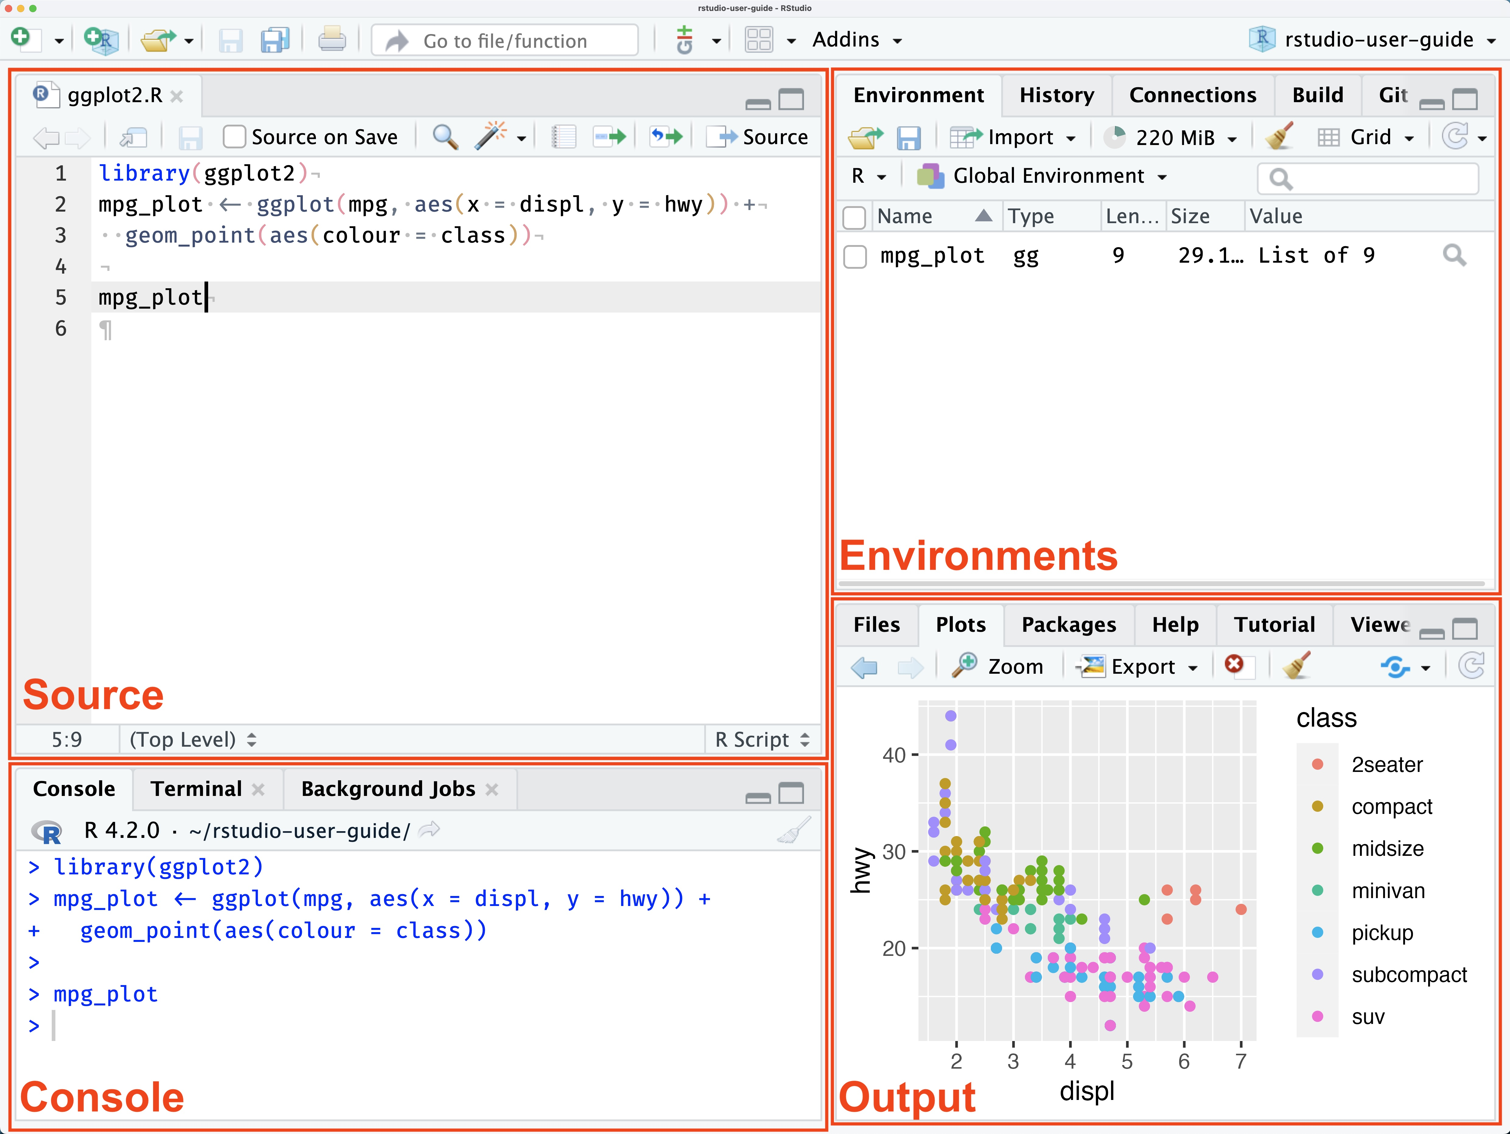
Interacting with R

Slide 40
Interacting with RStudio
Good practice to organise code into specific projects
Implemented as separate folders for separate projects
RStudio creates a project file in project folder
.Rproj file extension
We will create one for this course

Slide 41
Interacting with RStudio
Creating an RStudio project
Under the File menu, click on New project, choose New directory, then New project
Enter a name and choose a convenient location for the new folder
This is the working directory
~/intro_to_r

Slide 42
Interacting with RStudio
Creating an RStudio project
Confirm that the folder named in the "Create project as a sub-directory of" box is where you want the working directory created.
Use the Browse button to change folders if needed.
Click on "Create project"

Slide 43
Interacting with RStudio
Creating an RStudio project
Locate the Files tab on the right of the screen
Click "New Folder" and create a folder named R within your newly created working directory
~/intro_to_r/R
This folder will store R scripts for this course

Slide 44
Interacting with RStudio
Project structures are not rigid or compulsory (at this stage)
Intended to help keep things organised
Suggested folders:
R
docs
data

Slide 45
Interacting with RStudio
~/intro_to_r/
/R
/data
/docs
Working directory
R scripts
Data files
External documents
emails, manuscripts etc etc

Slide 46
Interacting with RStudio
Creating an RStudio project
Create a new R file (File > New File > R script) and save to the R directory
e.g. my_script.R
Enter a calculation again: + - / * ^
2 + 40
With cursor on the same line press Ctrl + return ⏎

Slide 47
End of Part 1

Slide 48
End of Part 1
Break
Review material so far
Open an R console
Do some calculations
Try and break something!
Questions??

Slide 49
Fundamentals of R
R code introduction
Comments
Arithmetic and logical operators
R fundamentals
Objects
Functions
Vectors and data types
Packages
Help

Slide 50
Fundamentals of R
R code introduction
Comments
Arithmetic and logical operators
R fundamentals
Objects
Functions
Vectors and data types
Packages
Help
😱

Slide 51
R code introduction
Download file:
session_1.R
https://github.com/bakenzua/gstt_critical_care_introduction_to_r/raw/refs/heads/main/session_1/session_1.R
Save the downloaded file to R folder in the RStudio project created earlier
Open the file in RStudio

Slide 52
R code introduction
Demo

Slide 53
Objects
Objects are "things" in the environment
Objects can be simple or complex
Integer
Study data set
Genome
Objects have names

Slide 54
Object names
There are only two hard things in Computer Science: cache invalidation and naming things - Phil Karlton
Names
Be descriptive and unambiguous
Be specific and consistent

Slide 55
Object names
x, height_cms, study_id
Rules
Case sensitive
Can not start with a number
Should not contain spaces
R has reserved words that cannot be used:
if, else, repeat, while, function, for, in, next, break
Can not use function names
snake_case

Slide 56
Objects
Create objects through assignment
Assign values to objects
<- is the assignment operator.
height_cms <- 180
Read <- as "goes in to"

Slide 57
Objects
Objects vs. Variables
Many programming languages have variables:
Name
Current value
Data type
Memory location
Requires bookkeeping of memory, error prone
R abstracts this away - Objects

Slide 58
Objects
Demo

Slide 59
Functions
Key feature of R
Built in capabilities or available from packages (external libraries)
Routines
Algorithms
Canned scripts
Or write your own!

Slide 60
Functions
Examples:
sqrt() sin() exp() log() log10()
round() ceiling()
Function name followed by round brackets

Slide 61
Functions
Demo

Slide 62
Functions
> sqrt(25) # call sqrt function with argument 25
5 # returns 5
Have names e.g. sqrt
Same rules as objects
run or call functions
Receive input or arguments
May return an object

Slide 63
Function arguments
Can be anything not just numbers
e.g. filenames, other objects
Functions can have more than one argument
What each argument means differs per function
Specifics can found in the function’s documentation

Slide 64
Function arguments
An argument can alter the way a function operates, such as whether to ignore ‘bad values’
such an argument is sometimes called an option
Arguments can have default values
Arguments can have names

Slide 65
Function arguments
Demo

Slide 66
Function documentation
Prefix a function name with ?
?round
Useful sections:
Usage
Arguments
Examples

Slide 67
Function documentation
R is very well documented
Documentation is written alongside the code
Available from within R
Available on the web
https://www.rdocumentation.org
?round
Documentation can be dry and technical
There is sometimes too much!
Can be very useful academically, theoretical explanations and citations

Slide 68
Function creation
Trivial to write functions in R
add_five <- function(a) {
x <- a + 5
return(x)
}

Slide 69
Function creation
Why write our own functions?
Improve readability
Reduce errors
Code often becomes very repetitive
import data from file, apply calculations (e.g.. calculate mechanical power)
import data from a different file, apply same calculations
import data from yet another file, apply same calculations
Write this import process and calculations into a single function
import_and_transform_my_research_data(data_filename)

Slide 70
Function creation
Code compiled into to a function is only written once:
One chance to make a mistake vs. many
One place to edit code vs many
Don’t repeat yourself – DRY
Rule of thumb: Repeat code three times, consider wrapping it into a function

Slide 71
Function documentation and creation
Demo

Slide 72
Mini break!

Slide 73
Vectors
Common and fundamental data structure in R
Collection of contiguous cells, where each cell contains one value
Can assign, <-, a vector to a named object
weights_kg <- c(70, 82, 115)
weights_kg is now a collection of three weights

Slide 74
Vectors
weights_kg <- c(70, 82, 115)
Values are separated by commas ,
Note that create a vector object with a function: c( )
c( ) named as short for "combine"

Slide 75
Vectors
Perform mathematical operations on vectors
weights_kg <- c(70, 82, 115)
2.2 * weights_kg
weights_kg > 80
Run functions on vectors

Slide 76
Vectors
A very common function is length() which counts the elements of a vector
length(weights_kg)
All the values we have used so far were vectors of length 1
Append elements to vectors:
weights_kg <- c(weights_kg, 130)

Slide 77
Indexing vectors
Selecting specific elements from a vector - indexing
Use square brackets and specify index(es) of element
weights_kg <- c(70, 82, 115)
# first element
weights_kg[1]
# first and thirds elements
weights_kg[c(1,3)]

Slide 78
Indexing vectors
Selecting specific elements from a vector - indexing
Use square brackets and specify index(es) of element
# first and thirds elements
weights_kg[c(1,3)]
Note that indexes begin at 1 in R
Different to other C like languages including Python

Slide 79
Indexing vectors
Specify indexes logically
# first and third elements
weights_kg[c(TRUE, FALSE, TRUE)]
Logical indexing is very powerful and is commonly used
Consider the following:
weights_kg[weights_kg > 70]

Slide 80
Vectors instead of loops
Loops are common in other programming languages
while
for…..next
Vectors, vectorised functions and indexing can often provide the same functionality in R
Hand built loops can be very slow or resource intensive in R

Slide 81
Vectors
Demo

Slide 82
Data types
The values contained in a vector, are all the same data type
numeric
Integers (or whole numbers ): 1, 2, 3, 4,
Floating point numbers (or floats): 1.2, 3.1415, 1.6x10⁶ = 1,600,000
logical (sometimes referred to as Boolean)
TRUE FALSE

Slide 83
Strings
character
Characters, text, strings
some_letters <- c("a", "b", "c")
patient_names <- c("Tom", "Barney", "Luigi")
Define a string or character type by delimiting with double quote marks "
Can use single quotes ‘Barney’, but good practice to use double quotes and be consistent

Slide 84

Strings
character
Characters, text, strings
Strings and character data is very common
Common tasks are often available as functions
https://stringr.tidyverse.org/
https://r4ds.had.co.nz/strings.html

Slide 85

Dates and Times
Another common data type
Dates are hard
Quite complex
How many days in a year?
How many seconds in an hour?
11/11/2024
11/13/2024
https://lubridate.tidyverse.org/
https://r4ds.had.co.nz/dates-and-times.html

Slide 86

Factors
Factors
Factors are categorical data
Can be ordered: Mild, Moderate, Severe
Can be unordered: Red, Blue, Green
Common to use strings to represent different categories or factors
Reference category
https://forcats.tidyverse.org/
https://r4ds.had.co.nz/factors.html

Slide 87
Convert data types
Often need to convert between data types
Functions that begin with "as."
as.numeric("3")
as.character(3)

Slide 88
More data structures and data types
R has more data structures
Lists
Matrices & Arrays
Data frames
Data types
complex
1 + 4i
raw
Custom types e.g. Interval

Slide 89
Data Types
Demo

Slide 90
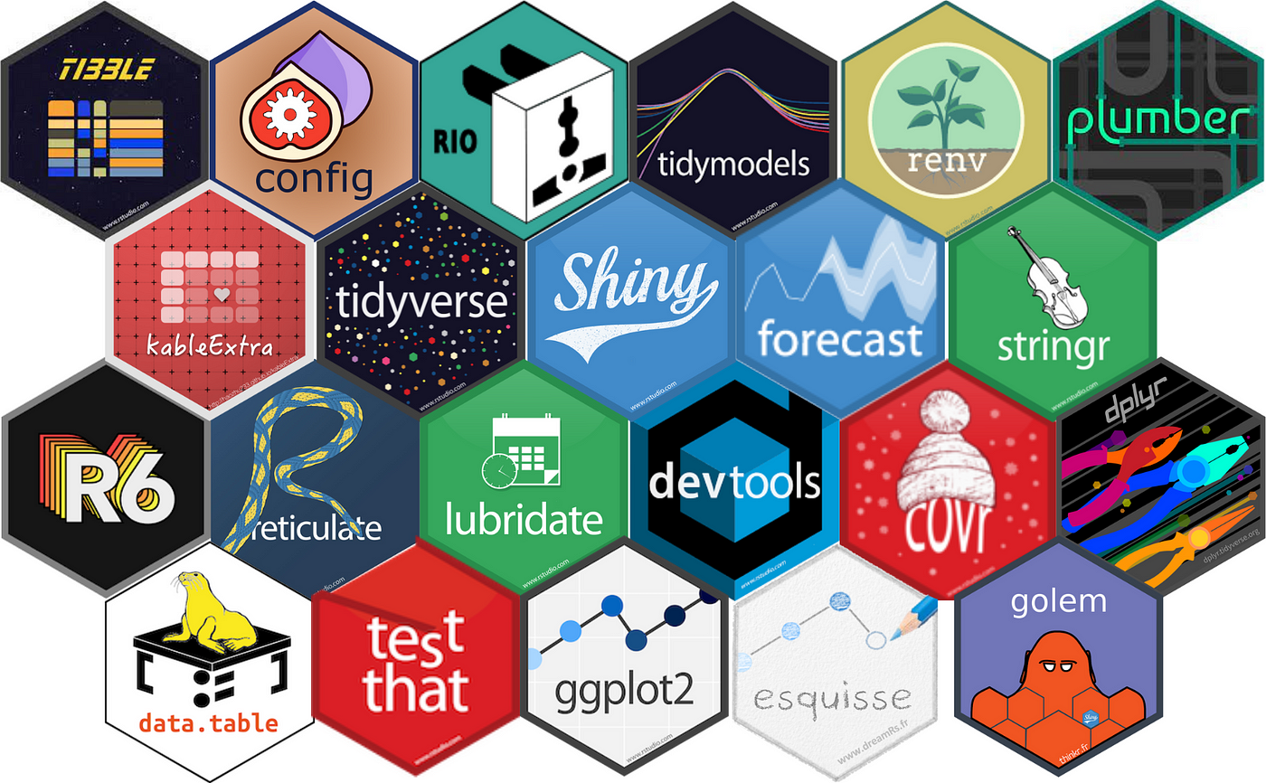
Packages
Packages contain useful R code written by other people

Slide 91
Packages
Packages provide extra functionality to that already included in ‘base R’
Easy data manipulation
Easy date manipulations
Bayesian statistics
Plotting survival curves
Functionality is provided through new functions

Slide 92
Packages
Installing packages
> install.packages("lubridate")
Load packages into your R environment
> library(lubridate)

Slide 93
Packages
If a package is installed, functions from that package can be used without library() call, via :: operator
> lubridate::ymd("2024-12-25")
package name :: function

Slide 94
Packages
Next sessions will use a set of packages named the tidyverse
Coherent set of tools for data manipulation and plotting
> install.packages("tidyverse")
https://www.tidyverse.org/
Especially be using dplyr and tidyr packages

Slide 95
Help
Function documentation
?round
?lubridate::dmy
Don’t know the function?
help.search("kruskal")
Only works for installed packages

Slide 96
Help - Error codes and messages
When code is incorrect, or R does not understand the command it will produce error messages
Often very cryptic
Read carefully for clues
Google it!
https://stackoverflow.com/

Slide 97
Wrap up
This session is a lot!
Take some time to digest, especially if you have never encountered a programming language before
Go back through the session_1.R file
Run each line again and make sure you understand and if not ask the question

Slide 98
Wrap up
Learn by using language
Reading
Writing
Make mistakes
Screencasts, AdventOfCode, TidyTuesdays
1000s of functions
can’t and don’t remember them all
google.com
stackoverflow.com

Slide 99

Resources
www.r-project.org
R for Data Science
Big Book of R
https://www.rscreencasts.com/
Rstudio cheat sheet
Data Carpentry in R

Slide 100
End of Part 2

Slide 101
End of Part 2
Review material since episode 1
Questions??

